Slide 1
Beginner Vimtorial
Welcome!
Please login to your Ducss or Netsoc account with putty or open your OS's terminal.
If you don't know how to do this let us know!

Slide 2
Format of this tutorial
Introduction to Vim
Introduction to common commands
Real world examples
Tips & Tricks
Vim config

Slide 3
Introduction to Vim

Slide 4
What is Vim?
Vim is a Text Editor (created 1991)
It is based off the editor 'Vi' (created 1976) and is short for 'Vi improved'
It is typically a command line text editor, using the keyboard to navigate and edit text
It or Vi is included in almost every Linux/Unix machine running
Widely considered to be the best text editor for programmers

Slide 5
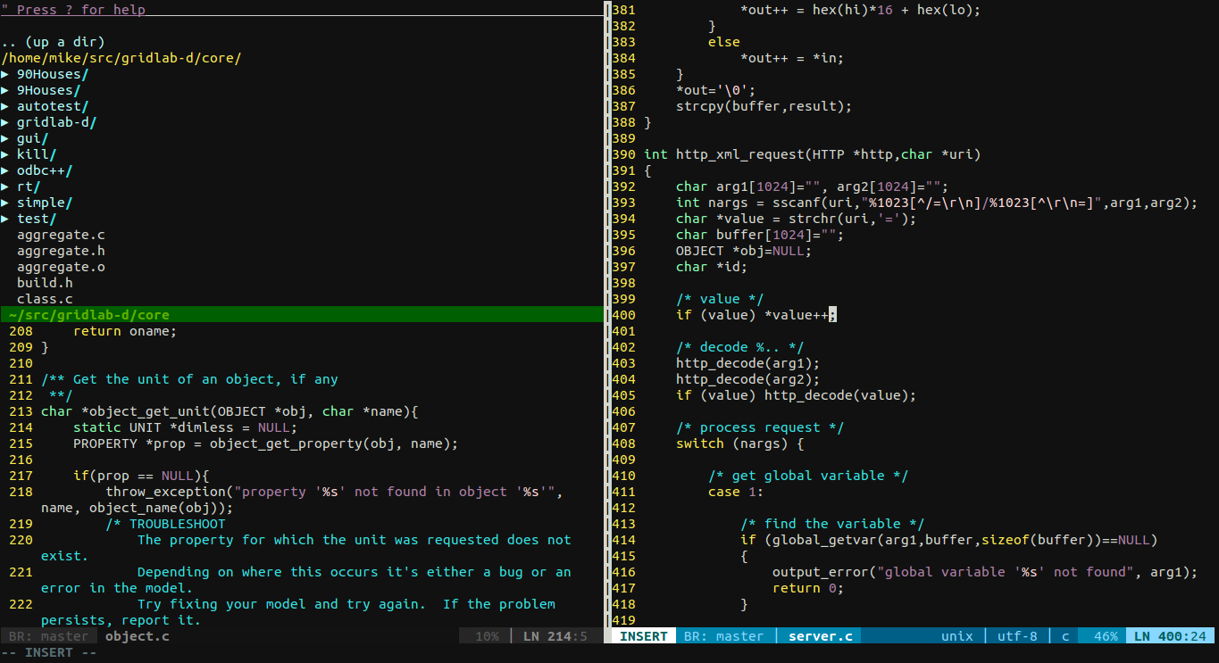

Slide 6
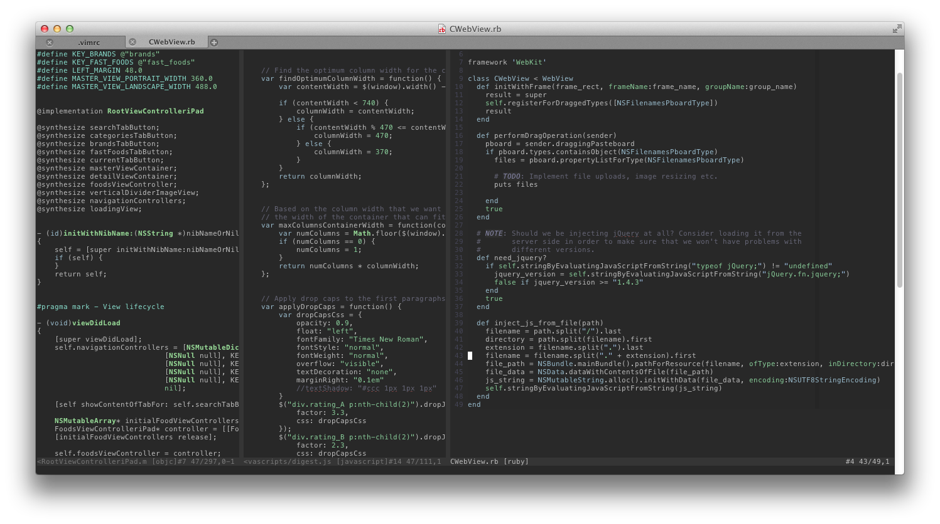

Slide 7
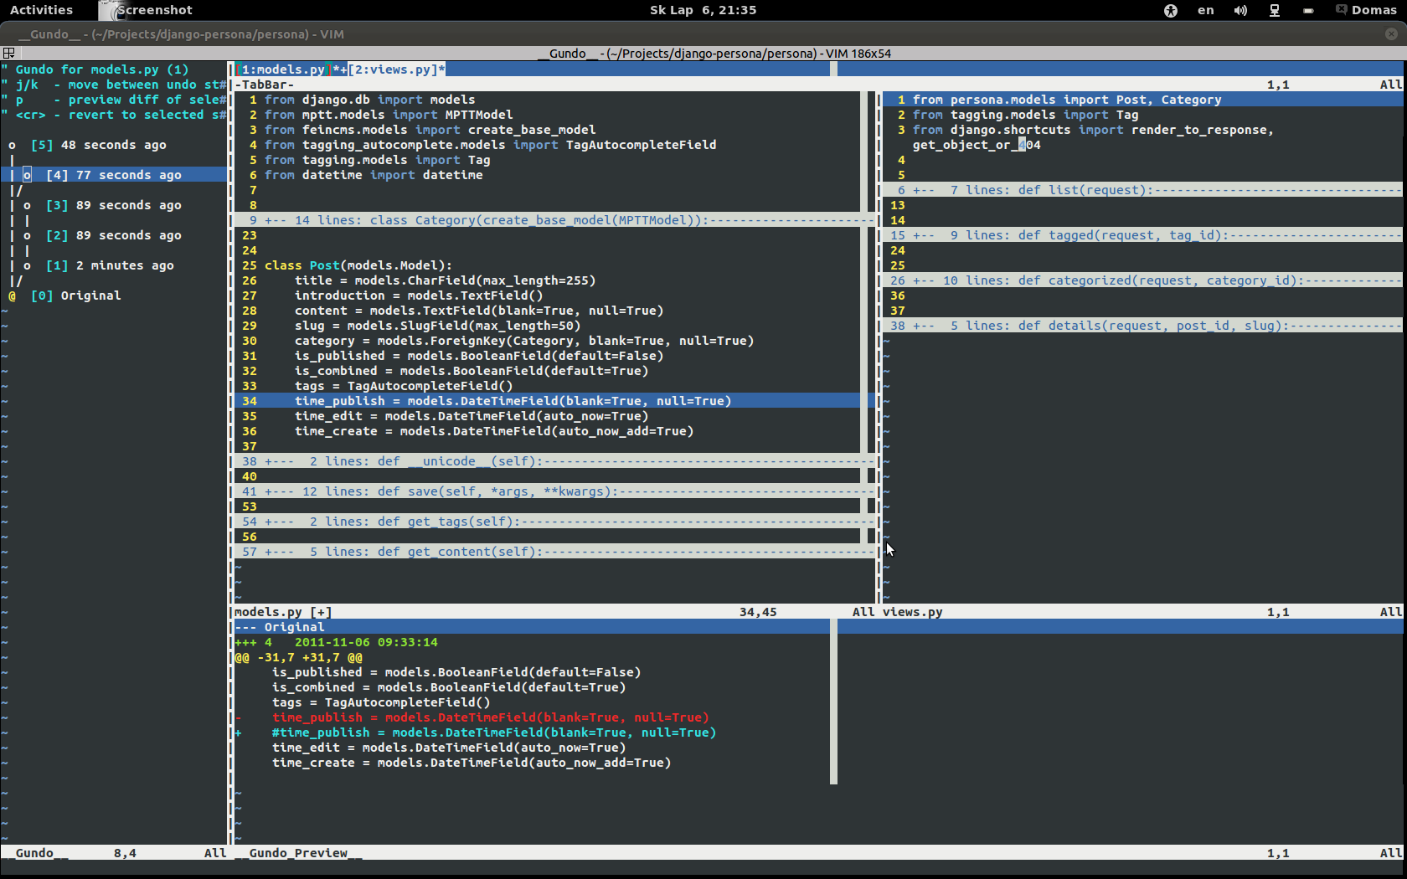

Slide 8
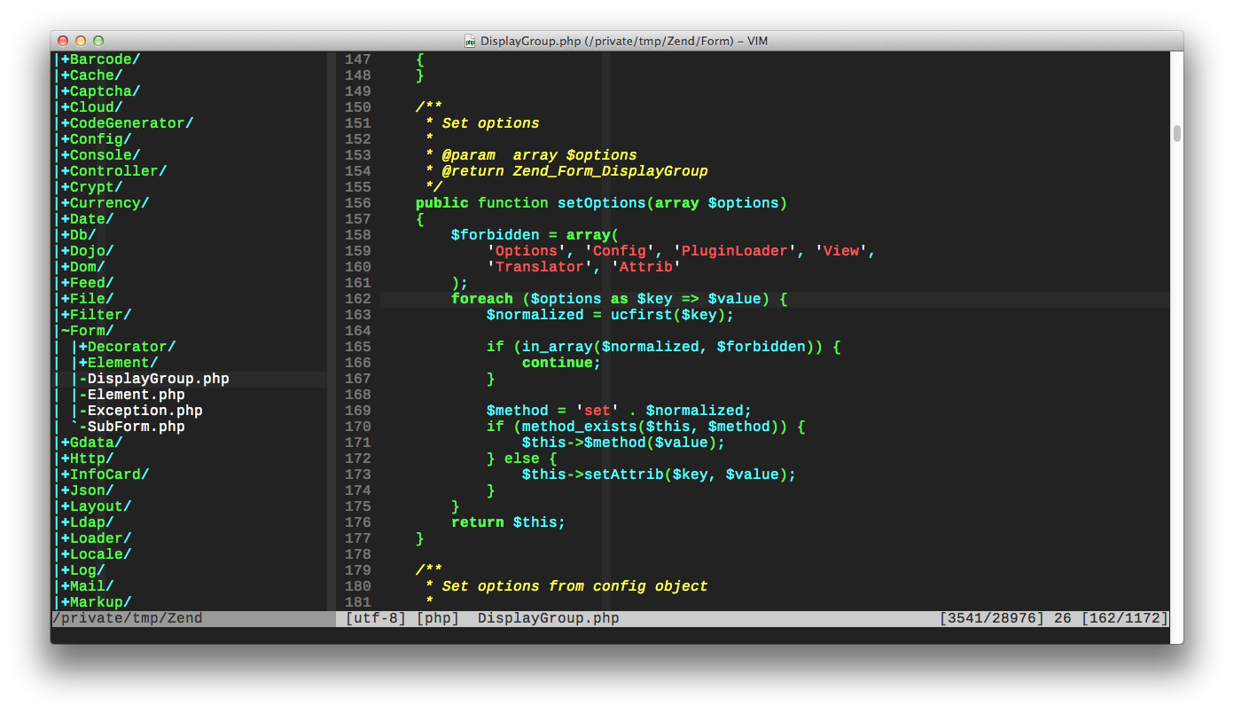

Slide 9
What makes Vim different?
It is a Modal text editor (explained later)
When editing with vim you rarely need to take your hands away from the home keys
Vim is incredibly powerful and includes a huge array of features
Vim is very small, not resource heavy and starts very quickly
Because it has been around for so long, there is a massive community of dedicated users

Slide 10
Vim has a steep learning curve!
Getting to know vim is difficult, but it is very worth it
Learning vim now will pay off over and over
There's pretty much always something to learn, and very few could call themselves experts

Slide 11
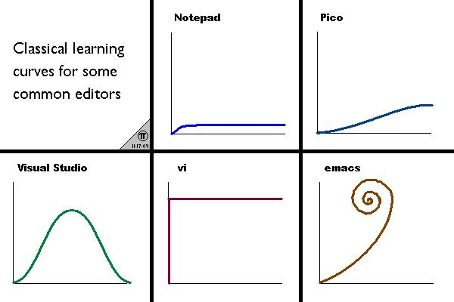

Slide 12
What is a Modal text editor
Modal means using modes
There are 6 modes in vim, and depending on which mode you're in vim will treat keyboard input differently
Because of this you never need to move your hands from the home keys, as all the characters from [a..z] can be interpreted as commands in different modes
Today we will focus on 2 modes to keep things simple

Slide 13
What are the modes
Normal (Command mode)
Insert (Enter text)
Visual (Select things visually)
Command Line (Run commands and scripts)
Ex Mode (Used for optimisation)
Select (rarely used – CUA complient)
We will be focusing on Normal and Insert Mode

Slide 14
Normal Mode
Normal mode is the most commonly used mode.
It takes different keyboard inputs as commands to manipulate text.
It is case sensitive
Eg:
p – paste
u – undo
i – enter insert mode
You might find the name counter-intuitive as you don't enter text in this mode

Slide 15
Insert Mode
Use this mode to insert text
Keyboard values are taken literally
Pressing 'esc' will bring you back to command mode
Enter this mode from normal mode a number of ways, Eg.
i – Insert text at the cursor
A – Append text to the end of the line
r – replace the current character

Slide 16
Command line mode
Command-line mode is used to enter commands in a command line
Typical commands include find & replace, write a file, quit, enable line numbers etc.
You can enter this mode by pressing “:” in normal mode
You can exit this mode by running the command or pressing ctrl-c

Slide 17
If something goes wrong
The different modes and behaviours of vim can be confusing
If something goes wrong, you can almost always go back to normal mode by pressing “esc” or “ctrl-c”
From there you can undo/save/quit
If things are randomly spazzing out, check that you don't have caps lock on

Slide 18
Introduction to common commands

Slide 19
Absolute minimum
Open up a terminal and run “vim example.c”
When you start vim you will automatically be in normal mode and can't enter text
To enter text – press “i” and type in some code
When you have written something, press “esc” to go back to normal mode
To save the file, enter command line mode with “:” and type “w” and enter
To quit type “:q” and enter
So to write and quit, you can run “:wq” (remember to type these, and most commands, one at at time)

Slide 20
Summary of absolute minimum
You opened vim
You went into insert mode with “i”
You typed some text
You went back to normal mode with “esc”
You wrote the file and quit with “:wq”
ez

Slide 21
Vimtutor
We're going to continue with the basics, trying a load of commands and recapping at the end
Type “vimtutor” in your terminal
Vimtutor lets you edit text and play around freely, and includes a basic vim tutorial
Nb - It does not listen to your config files for some reason

Slide 22
Basic Movement
To move around, do:
h – left
j – down
k – up
l – right
Don't argue with this, it will become natural with time
DON'T USE ARROW KEYS – as tempting as it is it just takes away the benifits you get from your hands being on the home keys

Slide 23
Basic Movement Cont'd
0 (that's a zero) – Go to beginning of line
^ - Go to the first non-whitespace character
$ - Go to the end of the line
% - Move to matching parenthesis, when the cursor is over one of them
gg – Go to the top of the file
G – Go to the bottom of the file
54gg – Go to line 54
And remember, HJKL – Left, Down, Up, Right

Slide 24
More practical movement
w – Move to the beginning of the next word
b – Move back to the beginning of a word
e – Move to the end of the current word
} - Move to start of next paragraph
{ - Move to start of previous paragraph
Ctrl-u – Scroll half a page up
Ctrl-d – Scroll half a page down
zz – center around your cursor (very handy)

Slide 25
Basic Editing
i – insert text at the cursor
a – append text after the cursor
I – inter text at the beginning of the line
A – Append text to the end of the linee
u - undo
r – replace the current character with another
After editing text, always go back to Normal Mode with ESC, make this a habit!

Slide 26
Basic Editing Cont'd
Generally when you delete something in vim, it is saved to a buffer and can then be pasted – Tf. most delete commands act the same as 'cut'
x – delete the character under the cursor
dd – delete a line
cc – change a whole line
d$ - delete from the cursor to the end of the line
yy – Copies the line
P – paste before cursor
p – paste after cursor

Slide 27
More practical editing
dw – delete word
3dd – delete 3 lines
cw – change word, change the text from the cursor to the end of the word
ctrl-r – redo an undo
. (that's a full stop) – Do the last command again
s – substitute (try S)
o – Start writing in next line (O for previous line)

